Slide 1
CSE 408
DESIGN AND ANALYSIS OF ALGORITHMS
Lecture #0
The kick start session

Slide 2
Course Details
Course Code:- CSE 408
LTP:- 3 0 2 [3 lectures, 2 practical's /week]
Credits:- 4

Slide 3
Course outcome
Through this course students should be able to:
CO1 :: Analyze the efficiency of algorithms using complexity analysis, recurrence solving techniques, and Divide-and-Conquer strategies.
CO2 :: Apply string matching algorithms, Trie data structures, and computational geometry techniques to solve pattern matching and geometric problems.
CO3 :: Apply Dynamic Programming techniques to solve optimization and combinatorial problems.
CO4 :: Apply Graph algorithms, Network Optimization, and Greedy techniques to solve graph-based optimization problems.
CO5 :: Apply Transform-and-Conquer and advanced algorithmic techniques to solve searching, sorting, and sequence-processing problems efficiently.
CO6 :: Evaluate the suitability of Backtracking, Branch and Bound, Approximation Algorithms, and Complexity Classes for solving computationally hard problems.

Slide 4
Program outcome
PO1: Apply the knowledge of mathematics, science, engineering fundamentals, and an engineering specialization to the solution of complex engineering problems.
PO2: Identify, formulate, review research literature, and analyse complex engineering problems reaching substantiated conclusions using first principles of mathematics, natural sciences and engineering sciences.
PO3: Design solutions for complex engineering problems and design system components or processes that meet the specified needs with appropriate consideration for the public health and safety, and the cultural, societal, and environmental considerations.
PO4: Use research-based knowledge and research methods including design of experiments, analysis and interpretation of data, and synthesis of the information to provide valid conclusions.
PO5: Create, select, and apply appropriate techniques, resources, and modern engineering and IT tools including prediction and modeling to complex engineering activities with an understanding of the limitations.
PO6: Apply reasoning informed by the contextual knowledge to assess societal, health, safety, legal and cultural issues and the consequent responsibilities relevant to the professional engineering practice.

Slide 5
Program outcome
PO7: Understand the impact of the professional engineering solutions in societal and environmental contexts, and demonstrate the knowledge of, and need for sustainable development.
PO8: Apply ethical principles and commit to professional ethics and responsibilities and norms of the engineering practice.
PO9: Function effectively as an individual, and as a member or leader in diverse teams, and in multidisciplinary settings.
PO10: Communicate effectively on complex engineering activities with the engineering community and with society at large, such as being able to comprehend and write effective reports and design documentation, make effective presentations, and give and receive clear instructions.
PO11: Project Management and Finance: Demonstrate knowledge and understanding of the engineering and management principles and apply these to one's own work, as a member and leader in a team, to manage projects and in multidisciplinary environments.
PO12: Life-long Learning: Recognize the need for, and have the preparation and ability to engage in independent and lifelong learning in the broadest context of technological change.

Slide 6
Program-Specific Outcomes (PSOs)
PSO1: Apply basic knowledge in the areas such as Software Engineering, Networking & Security, Database Management Systems, Intelligent Systems, Operating Systems and System Architecture for building software products.
PSO2: Attain the ability to design and develop software based systems, evaluate and recognize potential risks and provides creative, economical and optimal solutions.
PSO3: Provide effective and efficient real time solutions using attained knowledge in inter-disciplinary domains for societal benefits through projects.
PSO4: Ability to adapt future technologies through acquired skills and knowledge to ideate, design, test and deploy solutions for different business environments.

Slide 7
Course contents
Unit I
Analysis of Algorithms and Complexity Measures : Time and Space Complexity, Complexity Analysis of Insertion Sort and Merge Sort, Analysis of Iterative Algorithms, Analysis of Recursive Algorithms: Substitution Method, Recursion Tree Method and Master Method Divide-and-Conquer Technique : Strassen’s Matrix Multiplication, Order Statistics: Quick select, kth Smallest and k-th Largest Element
Unit II
String Matching Algorithms and Computational Geometry : Sequential Search and Brute-Force String Matching, Naive Pattern Matching, Rabin-Karp Algorithm, Knuth-Morris-Pratt Algorithm, Data Structures for String Processing: Trie (Prefix Tree), Computational Geometry: Closest-Pair Problem, Convex Hull

Slide 8
Course contents
Unit III
Dynamic Programming : Introduction to Dynamic Programming, Computing a Binomial Coefficient, Memory Functions, Knapsack Problem, Matrix-Chain Multiplication, Longest Common Subsequence, Optimal Binary Search Trees
Unit IV
Graph Algorithms and Network Optimization : Introduction to Graphs, Breadth-First Search (BFS), Depth-First Search (DFS), Topological Sort Greedy Technique : Introduction to Greedy approach, Knapsack Problem, Minimum Spanning Trees, Prim’s Algorithm, Kruskal’s Algorithm, Single-Source Shortest Paths, All-Pairs Shortest Paths

Slide 9
Course contents
Unit V
Transform-and-Conquer Techniques : Balanced Search Trees, Counting Sort, Radix Sort, Bucket Sort Advanced Algorithmic Techniques : Monotonic Stack, Monotonic Queue, Two pointers Technique
Unit VI
Backtracking, Approximation and Complexity Classes : n-Queens Problem, Hamiltonian Circuit, Subset-Sum Problem, Branch and Bound: Assignment Problem, Knapsack Problem, Traveling Salesman Problem, Approximation Algorithms: Vertex-Cover, Set-Covering, Bin Packing Problems, Complexity Classes: Concepts of P, NP, NP-Hard, NP-Complete Problems

Slide 10
List of Practical
1. Implement Insertion Sort algorithm and analyze its time complexity.
2. Implement Merge Sort algorithm and analyze its time complexity.
3. Implement Strassen's Matrix Multiplication algorithm.
4. Implement the Quick Select algorithm to find the k-th smallest and k-th largest element. .
5. Implement the Naïve String Matching algorithm.
6. Implement the Rabin-Karp algorithm for string matching using hashing.
7. Implement the Knuth-Morris-Pratt (KMP) algorithm for efficient string matching.
8. Implement a Trie (Prefix Tree) for insertion and searching of strings.
9. Implement the Convex Hull algorithm using Graham Scan
10. Implement the Longest Common Subsequence (LCS) algorithm using Dynamic Programming.

Slide 11
List of Practical
11. Implement Matrix Chain Multiplication using Dynamic Programming.
12. Implement the 0/1 Knapsack problem using Dynamic Programming.
13. Implement Breadth-First Search (BFS) and Depth-First Search (DFS) graph traversal algorithms
14. Implement Prim's algorithm to find the Minimum Spanning Tree of a weighted graph.
15. Implement Kruskal's algorithm to find the Minimum Spanning Tree of a weighted graph.
16. Implement Dijkstra's algorithm to find the Single-Source Shortest Path in a weighted graph
17. Implement the Largest Rectangle in Histogram problem using the Monotonic Stack technique.
18. Implement the Longest Palindromic Substring problem using the Two-Pointer technique.
19. Implement the N-Queens problem using the Backtracking technique.
20. Implement the Traveling Salesman Problem using the Branch and Bound technique.

Slide 12
Innovative Pedagogies
Pedagogy | Implementation
Case-Based Learning | Analysis of real-world applications such as Google Maps (Shortest Path), GPS Navigation, Huffman Coding, Scheduling, and Data Compression.
Hands-on Practical Learning | Implementation of sorting, graph, greedy, dynamic programming, backtracking, and branch-and-bound algorithms using C++.
Quizzes | Short quizzes on algorithm design techniques, recurrence relations, asymptotic analysis, and problem-solving strategies.
Multimedia Tools | Live demonstrations using algorithm visualizers (VisuAlgo, Algorithm Visualizer), animations, and interactive presentations.

Slide 13


Assessment & Evaluation Framework
CSE226 Marks weightage
Attendance 05
Academic Task (Total 3) 25
MTE (MCQs) 20
ETT (MCQs) 50
Total 100

Slide 14
Academic task Framework
Assessment Plan
Assessment | Objective | Mode | Marks | Week
Test 1 (MCQs) | Evaluate conceptual understanding, analytical thinking, and problem-solving skills. | Offline | 30 | Week 4–5
Test 2 (MCQs) | Assess students' understanding of algorithmic concepts and programming fundamentals. | Offline | 30 | Week 9–10
Code-Based Test | Evaluate algorithm design, implementation, testing, and optimization through coding problems. | Online (BYOD) | 30 | Week 12–13
Two Code-Based MCQ Tests will be conducted during the semester, and the best score will be considered for evaluation.
One BYOD Code-Based Practical Test is mandatory for all students.

Slide 15
Academic Task Framework
Code-Based MCQ Tests (30 Marks)
15 MCQs
30 Marks
Two tests will be conducted during the semester.
Best score will be considered for evaluation.
BYOD Practical Coding Test (30 Marks)
2 Programming Questions
Question 1: 15 Marks
Code Logic & Implementation – 10 Marks
Execution & Output Verification – 5 Marks
Question 2: 15 Marks
Code Logic & Implementation – 10 Marks
Execution & Output Verification – 5 Marks

Slide 16
Books
Text Books:
INTRODUCTION TO THE DESIGN AND ANALYSIS OF ALGORITHM by ANANY LEVITIN
Reference Book:
INTRODUCTION TO ALGORITHMS by C.E. LEISERSON, R.L. RIVEST AND C. STEIN

Slide 17
Learning Resources
Relevant Websites (RW)
Website | Salient Features
GeeksforGeeks (https://www.geeksforgeeks.org/dsa/) | Comprehensive DSA tutorials, coding examples, and interview-oriented problems
CP-Algorithms (https://cp-algorithms.com/) | Advanced algorithms with mathematical proofs and implementations
Programiz (https://www.programiz.com/dsa) | Beginner-friendly explanations and implementations
LeetCode (https://leetcode.com/problemset/algorithms/) | Algorithmic coding practice and interview preparation
HackerRank (https://www.hackerrank.com/domains/tutorials/10-days-of-algorithms) | Hands-on algorithm challenges and coding assessments
USACO Guide (https://usaco.guide/) | Structured learning path for algorithms and competitive programming

Slide 18
Virtual Labs (VL)
Website | Salient Features
VisuAlgo (https://visualgo.net/en) | Interactive visualization of algorithms and data structures
Algorithm Visualizer (https://algorithm-visualizer.org/) | Step-by-step execution and visualization of algorithms
Data Structure Visualizations (https://www.cs.usfca.edu/~galles/visualization/Algorithms.html) | Interactive visualization of trees, graphs, sorting, heaps, and graph algorithms

Slide 19
Placement & Career Relevance
💼 Employability Skills | 🏭 Industry Applications
• Algorithmic Thinking• Problem Solving• Complexity Analysis• Optimization Techniques• Coding & Debugging | • Software Development• Artificial Intelligence & ML• Data Science & Analytics• Cloud Computing• Network Optimization
👨‍💻 Career Opportunities | 🎓 Higher Studies & Competitive Exams
• Software Engineer• Backend Developer• Algorithm Engineer• AI/ML Engineer• Research Engineer | • GATE (CS)• UGC-NET (CS)• M.Tech./MS/Ph.D.• Coding Interviews• Competitive Programming

Slide 20

WHAT IS EDUCATION REVOLUTION?
Edu-Revolution at LPU is a transformative academic initiative aimed at creating a flexible, inclusive, and experiential learning environment.
Promotes student-centric learning by integrating real-world experiences, industry engagement, gamified learning practices, entrepreneurial activities, and extracurricular contributions into the formal academic framework.

Slide 21
Why EDU-Revolution!!!
Career Readiness
Enhance Real World Skills
Promote Innovation and Creativity
Foster Industry Relations
Develop Entrepreneurial Mindset
Increase Student Engagement and Motivation
Promote Lifelong Learning

Slide 22
Education Revolution: an approach that encourages…
Gamified Learning with AI focus - Learning Outside Classroom
Revenue Generation by Students
Career (not just degree)
Students in Decision Making

Slide 23
Pillar I: Gamified Learning with AI focus
50% Learning outside the classroom
50% grades outside the classroom
50% attendance outside the classroom
Formula: 50-50-50
Techniques of Learning Outside the Classroom
Projects
Technical Competitions & Hackathons
Social Media Presence
Recognition of Prior Learning
Paid Internship
Recruitment/Competitive/ Eligibility Examination
NPTEL/MOOCs
Community Service
Publications/Patents/ Copyrights

Slide 24
Gamified Learning: Benefits
Course Exemption
Grade Upgradation
No Pen-Paper based Evaluation
Attendance Relaxation
Duty Leaves
Value Addition in Academic Transcript

Slide 25
Pillar II: Revenue Generation
Where would Revenue Generation come from?
Industry/field consultancy projects
Freelancing activities
Paid internships
Establishing start- ups and entrepreneurial venture
Through University support:
Earn while Learn opportunities
Incentives for Publication/Patent/Copyright
You should be able to generate at least 50 % age of your semester fee every semester

Slide 26
Pillar II: Revenue Generation
Course Exemption/Grade upgradation
Student Centric Revenue Generation
Duty Leave
Important Points:
Submit authentic information only
Student must submit a detailed proposal outlining:
Revenue Model
Market Feasibility
Execution Strategy
Financial Projections
Earn exemptions from your revenue generation endeavors
Earn Academic benefits on revenues above 50,000 (in 6 months)

Slide 27
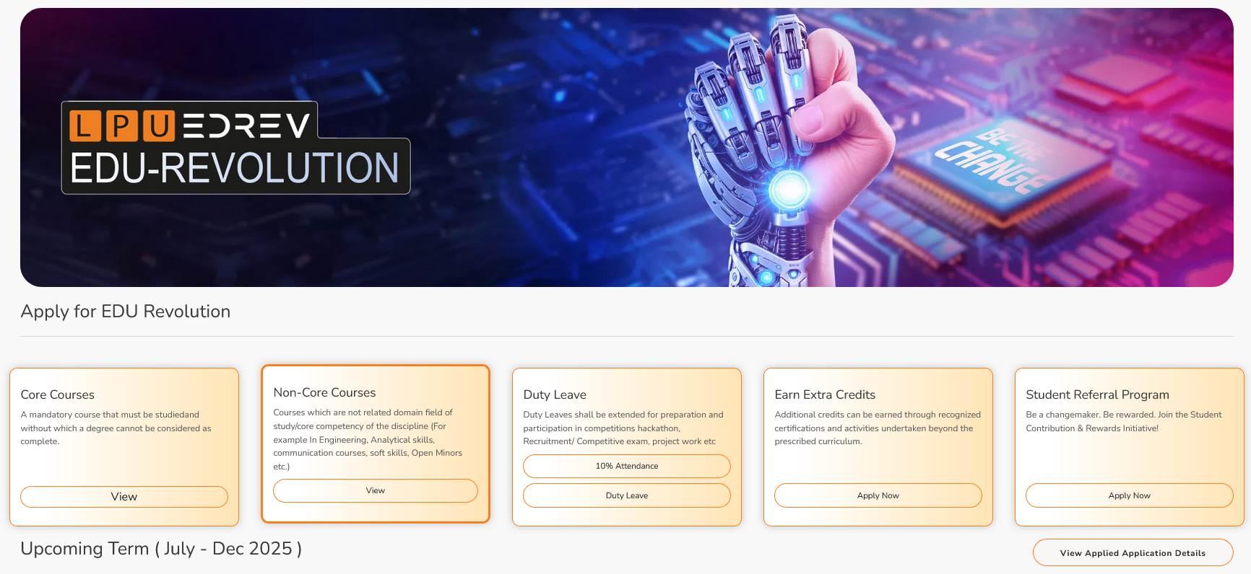
Where to View & Select Nomination Choices for Courses that students are studying
Step 1: Login to UMS -- Navigate to LMS -- EDREV: Be the Part of Change -- Options.

Slide 28
Applying for EDU-Revolution Initiatives
How can students apply:
Login UMS → LMS → EDU-Revolution: Be the Change → Apply for EDU- Revolution
Need Help:
Students can visit the EDU-Revolution Query & Assistance Zone at Block 27–102

Slide 29
Applying for EDU-Revolution Initiatives
Important Points
All student applications will be verified by the EDU-Revolution Standing Committee and the Committee may:
Contact you directly
Ask for supporting documents
Call for in-person interaction
Can approve/reject/change proposed benefits
Final decisions are based on merit, relevance & evidence

Slide 30
Pillar III: Career Pathway
"Your Journey, Your Choice: Build, Serve, or Study for Tomorrow!"
Corporate Jobs
Government
Jobs
Higher Studies
Entrepreneurship
Research
Study Abroad

Slide 31
Pillar III: Career Pathway
Career Pathways are at the core of our academic framework.
Curriculum is strategically designed to align with needs and requirements of each career pathway.
From technical proficiency to soft skills, the curriculum is tailored to develop a well-rounded professional ready for competitive market as per the chosen pathway.

Slide 32
Pillar III: Career Pathway
School Specific Success Stories for each pathway
(Highlighting student and their achievement for each pathway)

Slide 33
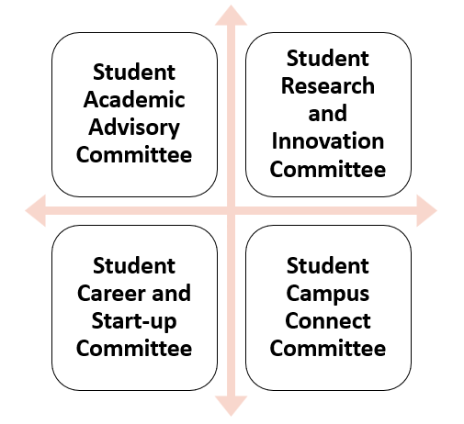
Pillar IV: Students in Decision Making
Committees under Student Education Revolution Board
We bring numerous ideas every year; but now, at least 20% of these ideas should originate from students themselves in all categories like academics, placements, research, entrepreneurship, etc.

Slide 34
Pillar IV: Students in Decision Making A platform to bring the Change
Research Area
Projects to Pursue
Funding opportunities
Identification of Real World Problems
Academic Benefits
Curriculum
Content
New Teaching Methods
New Evaluation Methods
Academic Benefits
National/International Internship
Bring New companies
International Placement opportunities
Entrepreneural Areas
Academic Benefits
Social Media Presence of Schools
Social Media Campaigns
Self Promotion
Academic Benefits

Slide 35
Applicability of EDU-Rev for CSE 408
Recognition of Prior Learning
Students who have enrolled in a course and have successfully cleared any proctored or non-proctored certification examination may apply for RPL (Recognition of Prior Learning), provided that the course content has at least 70% mapping with the course content for which the student is seeking RPL, and the submitted certificate is valid and verifiable.

